Slide 1
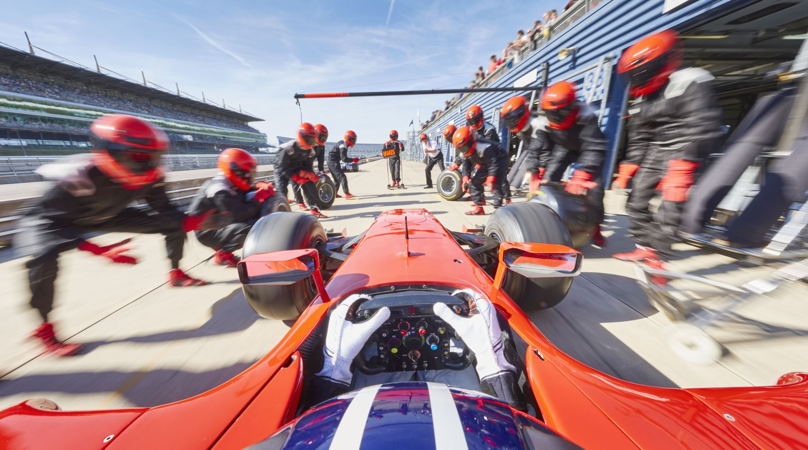
Modules 23,24 – Project 4
Formula One, Numbers, Facts, Directions

Slide 2
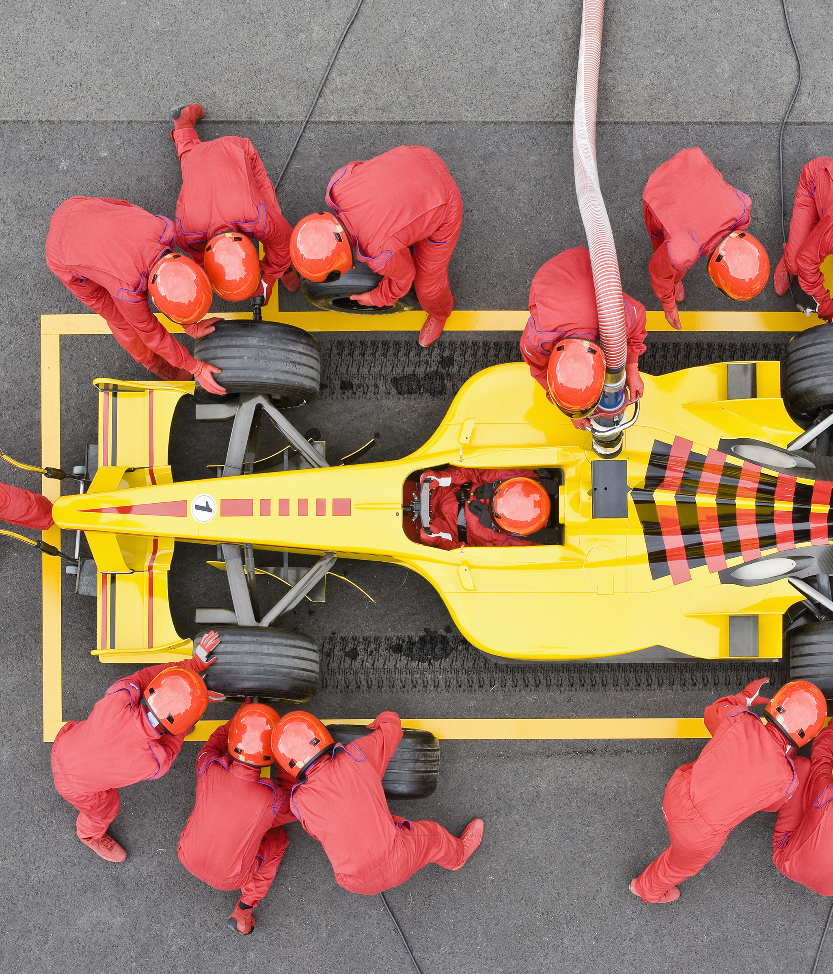
The Team
Tatiana Alveal
Adwoa Anto
Elias Hagos
J Eneas S Maria
Mabeyda Martinez

Slide 3
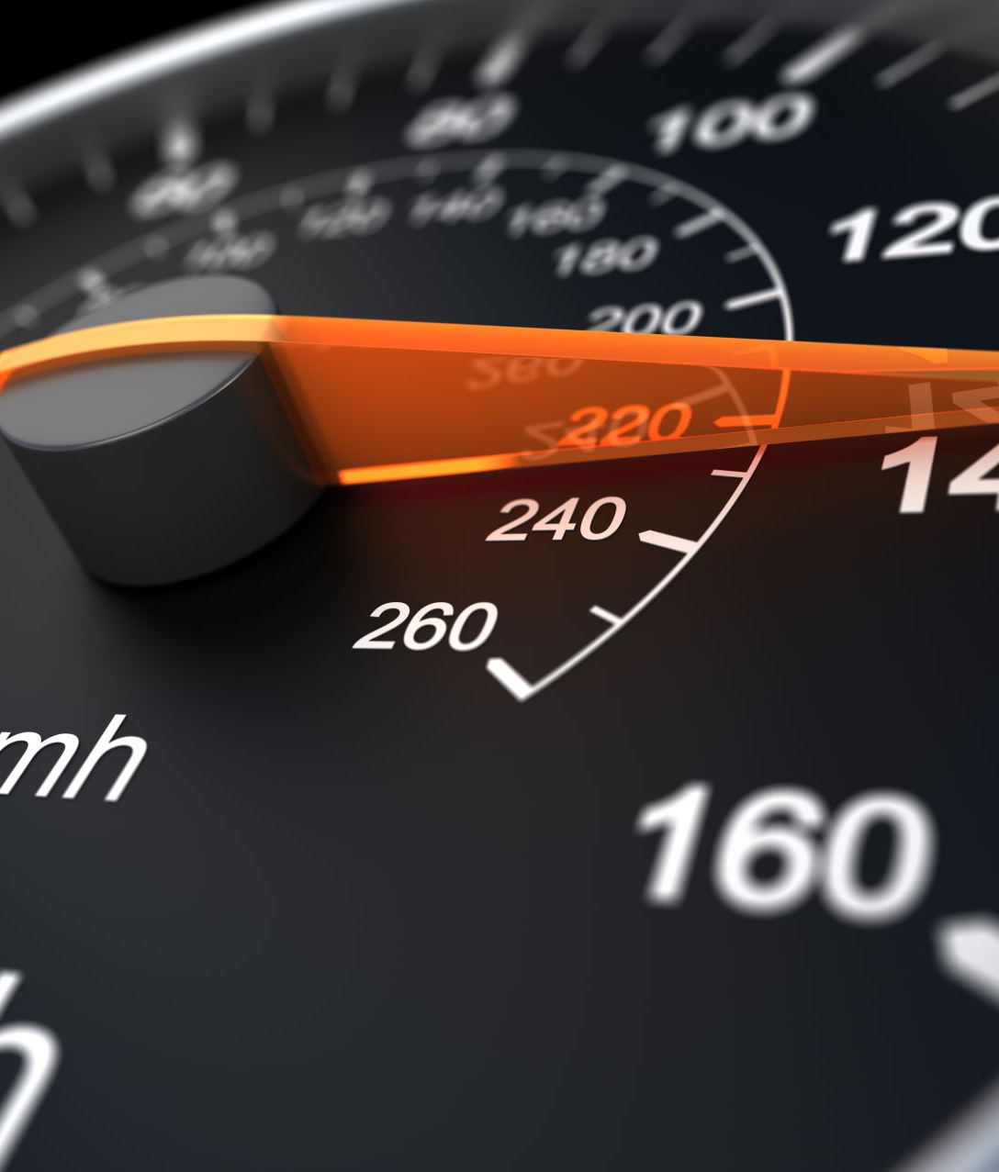
Project Scope
Formula One historical data
What the different numbers represent?
How many races? By year, by Country, etc?
How many team? Pilots?
How many accidents? Fatalities?
Formula One and Machine Learning
Can a model be created and trained?
Can predictions can be made?

Slide 4

Data Sources
From Kagle
Formula One Race Data (up to 2017)
https://www.kaggle.com/datasets/cjgdev/formula-1-race-data-19502017
Formula One Data Sets (2018-Present)
https://github.com/toUpperCase78/formula1-datasets/tree/master

Slide 5
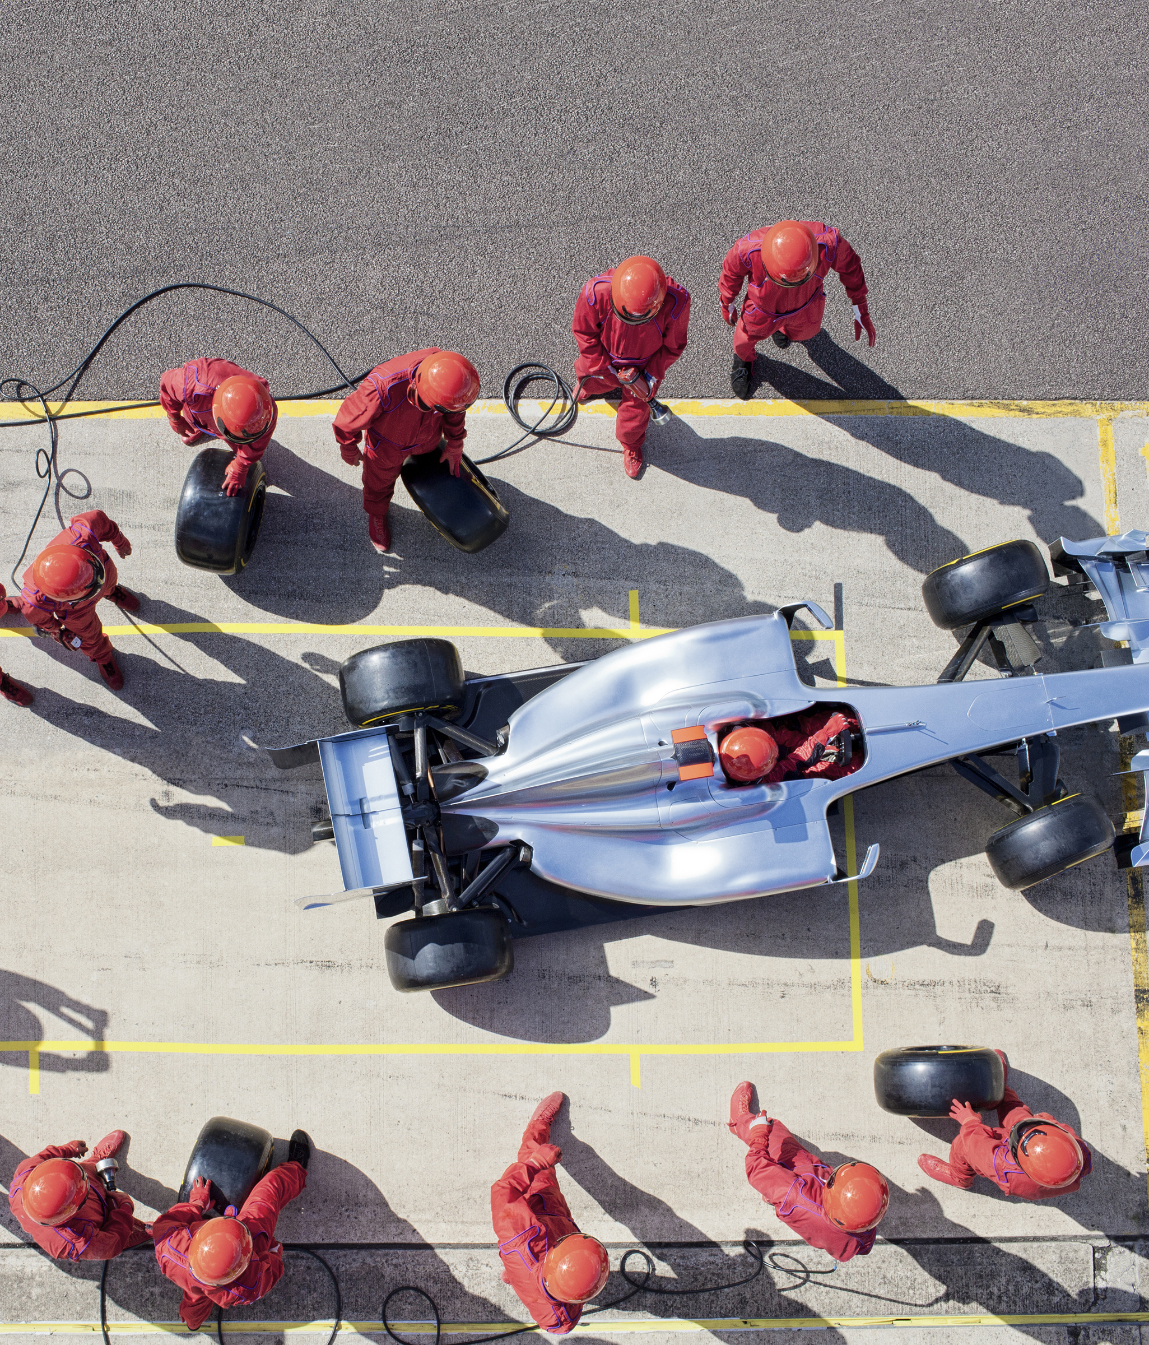
Project Deliverables
Data Model Design
Data cleansing
Data Loading
Data Summaries
ML modeling
ML training
ML prediction/validation
Data Visualization
Project Repository
Analysis and Reports

Slide 6
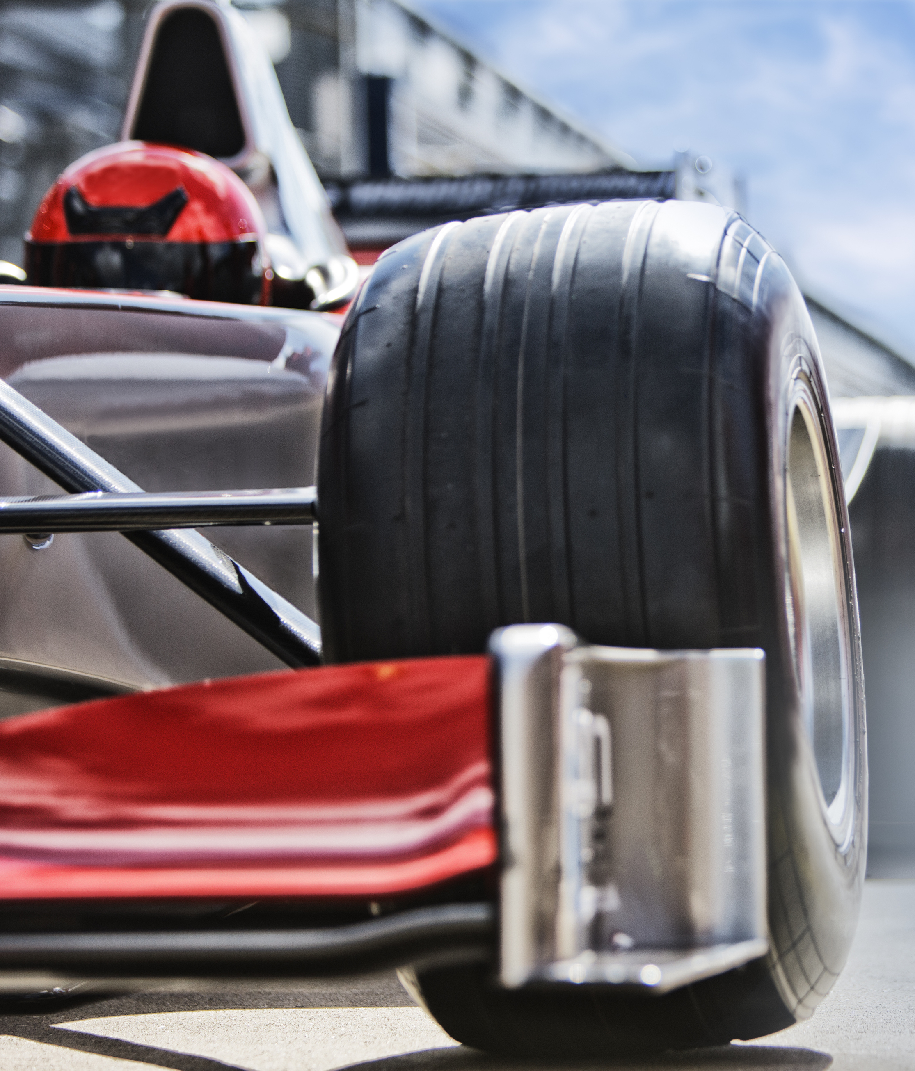
Project Technologies
Python (For batch processing)
Python Pandas
Python Matplotlib
Scikit-learn (for ML related work)
MongoDB (For data storage)
Tableau (For Data Visualization)

Slide 7
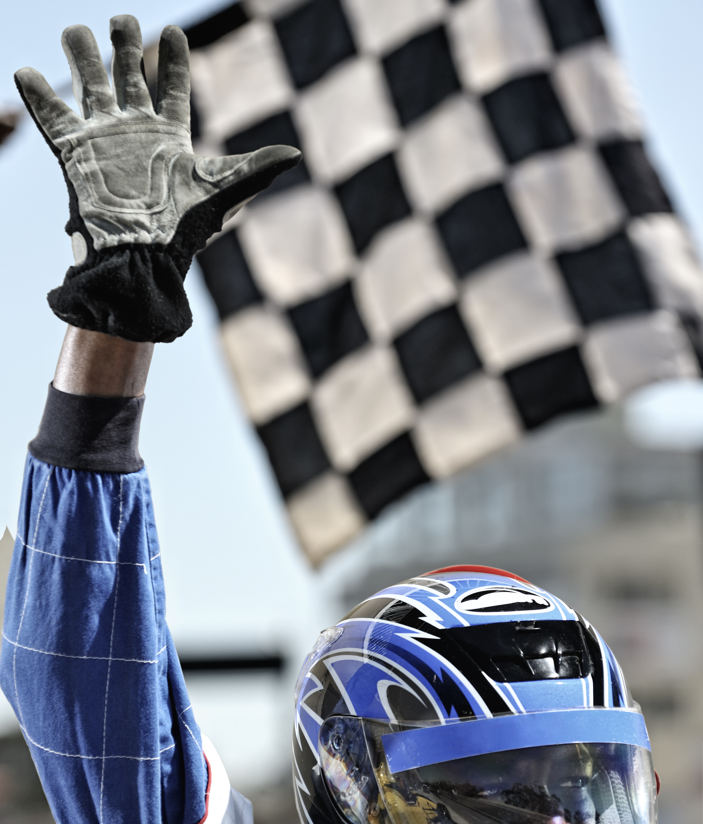
Project Work assignments
Tableau – Adwoa Anto
Data Modeling – J Eneas S Maria
Machine Learning - J Eneas S Maria & Mabeyda Martinez
Data Cleansing and Loading – Elias Hagos
Analysis and Reports – Whole Team
Data Summaries – Tatiana Alveal

